Slide 1

Artificial Intelligence Representing and Reasoning with Uncertain Knowledge
Dr. Pratibha C. Kaladeep (Dr. Pratibha S. Yalagi)
(pratibhayalagi@gmail.com )
Professor
Department of Computer Science and Engineering,
Walchand Institute of Technology,
Solapur.
www.witsolapur.org

Slide 2
Course Outcomes
- At the end of this course, students will be able to…
Formulate and solve sequence of actions for an agent as a search problem.
Infer from represented knowledge using logical and probabilistic reasoning methods
Solve agent decision problems using probability theory
Comprehend forms of learning and demonstrate their working.

Slide 3
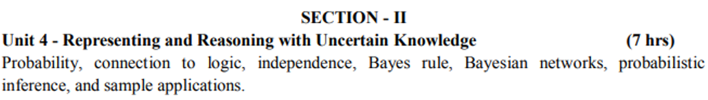
Syllabus

Slide 4
Introduction
In earlier units, we have learned knowledge representation using first-order logic and propositional logic with certainty, which means we were sure about the predicates.
With this knowledge representation, we might write A→B, which means if A is true then B is true.
But consider a situation where we are not sure about whether A is true or not then we cannot express this statement, this situation is called uncertainty.
So to represent uncertain knowledge, where we are not sure about the predicates, we need uncertain reasoning or probabilistic reasoning.
Def: Uncertainty is defined as the lack of exact information or knowledge that helps us to find a correct conclusion.

Slide 5
Introduction
Overview:
Partial Observable Environment
Non-deterministic Environment
Sources of Uncertainty
Uncertain Inputs
Uncertain Knowledge
Uncertain Output

Slide 6
Causes of Uncertainty
Missing / Unavailable Data
Unreliable / Ambiguous Data
Imprecise / Inconsistent Data
Guess Based Data
Default Based Data
Need of probabilistic reasoning in AI:
When there are unpredictable outcomes.
When specifications or possibilities of predicates becomes too large to handle.
When an unknown error occurs during an experiment.

Slide 7
An example of uncertain reasoning
Diagnosing a dental patient’s toothache
Diagnosis—whether for medicine, automobile repair, or whatever—almost always involves uncertainty.
Let us try to write rules for dental diagnosis using propositional logic, so that we can see how the logical approach breaks down.
Consider the following simple rule:
Toothache ⇒ Cavity .
The problem is that this rule is wrong. Not all patients with toothaches have cavities; some of them have gum disease, an abscess, or one of several other problems:
Toothache ⇒ Cavity ∨ GumProblem ∨ Abscess ...
Unfortunately, in order to make the rule true, we have to add an almost unlimited list of possible problems.

Slide 8
An example of uncertain reasoning
We could try turning the rule into a causal rule:
Cavity ⇒ Toothache.
But this rule is not right either; not all cavities cause pain.
The only way to fix the rule is to make it logically exhaustive: to augment the left-hand side with all the qualifications required for a cavity to cause a toothache.
Trying to use logic to cope with a domain like medical diagnosis thus fails for three main reasons:
Laziness: It is too much work to list the complete set of antecedents or consequents needed to ensure an exceptionless rule and too hard to use such rules.
Theoretical ignorance: Medical science has no complete theory for the domain.
Practical ignorance: Even if we know all the rules, we might be uncertain about a particular patient because not all the necessary tests have been or can be run.

Slide 9
An example of uncertain reasoning
The connection between toothaches and cavities is just not a logical consequence in either direction.
This is typical of the medical domain, as well as most other judgmental domains: law, business, design, automobile repair, gardening, dating, and so on.
The agent’s knowledge can at best provide only a degree of belief in the relevant sentences.
Our main tool for dealing with degrees of belief is probability theory.

Slide 10
Uncertainty and rational decisions
Consider again the A₉₀ plan for getting to the airport. Suppose it gives us a 97% chance of catching our flight. Does this mean it is a rational choice?
Not necessarily: there might be other plans, such as A₁₈₀, with higher probabilities. If it is vital not to miss the flight, then it is worth risking the longer wait at the airport.
What about A₁₄₄₀, a plan that involves leaving home 24 hours in advance? In most circumstances, this is not a good choice, because although it almost guarantees getting there on time, it involves an intolerable wait.
To make such choices, an agent must first have preferences between the different possible outcomes of the various plans.
An outcome is a completely specified state, including such factors as whether the agent arrives on time and the length of the wait at the airport.
We use utility theory to represent and reason with preferences. (The term utility is used here in the sense of “the quality of being useful”)
Utility theory says that every state has a degree of usefulness, or utility, to an agent and that the agent will prefer states with higher utility.

Slide 11
Uncertainty and rational decisions
Preferences, as expressed by utilities, are combined with probabilities in the general theory of rational decisions called decision theory:
Decision theory = probability theory + utility theory
The fundamental idea of decision theory is that an agent is rational if and only if it chooses the action that yields the highest expected utility, averaged over all the possible outcomes of the action. This is called the principle of maximum expected utility (MEU).
The structure of an agent that uses decision theory to select actions is given in next slide

Slide 12
Uncertainty and rational decisions
function DT-AGENT(percept) returns an action
persistent: belief state, probabilistic beliefs about the current state of the world
action, the agent’s action
update belief state based on action and percept
calculate outcome probabilities for actions,
given action descriptions and current belief state
select action with highest expected utility
given probabilities of outcomes and utility information
return action
Figure 4.1 A decision-theoretic agent that selects rational actions.

Slide 13
Probabilities
What probabilities mean?
Probabilistic assertions are about possible worlds.
They tell us about how probable the various worlds are.
In probability theory, the set of all possible worlds is called the Sample Space.
The possible worlds are mutually exclusive and exhaustive - two possible worlds cannot both be the case, and one possible world must be the case.
For example, if we are about to roll two (distinguishable) dice, there are 36 possible worlds to consider: (1,1), (1,2), ..., (6,6).
The Greek letter Ω (uppercase omega) is used to refer to the sample space, and ω (lowercase omega) refers to elements of the space, that is, particular possible worlds.

Slide 14
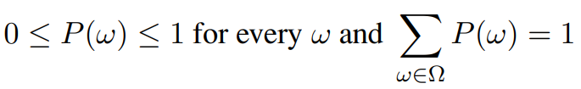
Probabilities
A fully specified probability model associates a numerical probability P(ω) with each possible world.
The basic axioms of probability theory say that every possible world has a probability between 0 and 1 and that the total probability of the set of possible worlds is 1:
(4.1)
For example, if we assume that each die is fair and the rolls don’t interfere with each other, then each of the possible worlds (1,1), (1,2), ..., (6,6) has probability 1/36.
On the other hand, if the dice conspire to produce the same number, then the worlds (1,1), (2,2), (3,3), etc., might have higher probabilities, leaving the others with lower probabilities.

Slide 15
Probabilities
Probabilistic assertions and queries are not usually about particular possible worlds, but about sets of them.
For example, we might be interested in the cases where the two dice add up to 11, the cases where doubles are rolled, and so on.
In probability theory, these sets are called events.
In AI, the sets are always described by propositions in a formal language.
For each proposition, the corresponding set contains just those possible worlds in which the proposition holds.

Slide 16

Probabilities
The probability associated with a proposition is defined to be the sum of the probabilities of the worlds in which it holds:
(4.2)
For example, when rolling fair dice, we have P(Total = 11) = P((5, 6)) + P((6, 5)) = 1/36 + 1/36 = 1/18.
Probabilities such as P(Total = 11) and P(doubles) are called unconditional or prior probabilities (and sometimes just “priors” for short); they refer to degrees of belief in propositions in the absence of any other information.

Slide 17
Probabilities
Most of the time, however, we have some information, usually called evidence, that has already been revealed.
For example, the first die may already be showing a 5 and we are waiting for the other one to stop spinning.
In that case, we are interested not in the unconditional probability of rolling doubles, but the conditional or posterior probability (or just “posterior” for short) of rolling doubles given that the first die is a 5.
Conditional probability is a probability of occurring an event when another event has already happened.

Slide 18
Probabilities
This probability is written P(doubles | Die₁ = 5), where the “ | ” is pronounced “given.”
Similarly, if I am going to the dentist for a regular checkup,
the probability P(cavity)=0.2 might be of interest;
but if I go to the dentist because I have a toothache,
it’s P(cavity |toothache)=0.6 that matters.
Note that the precedence of “ | ” is such that any expression of the form P(... | ...) always means P((...)|(...)).

Slide 19
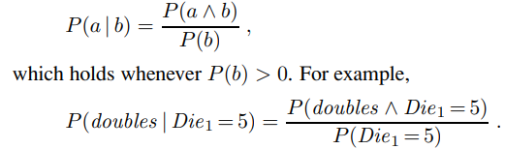
Probabilities
Mathematically speaking, conditional probabilities are defined in terms of unconditional probabilities as follows: for any propositions a and b, we have
(4.3)
Where P(a⋀b)= Joint probability of a and b
P(b)= Marginal probability of b.
The definition makes sense if you remember that observing b rules out all those possible worlds where b is false, leaving a set whose total probability is just P(b). Within that set, the a-worlds satisfy a ∧ b and constitute a fraction P(a ∧ b)/P(b).

Slide 20
Probabilities
The definition of conditional probability, Equation (4.3), can be written in a different form called the product rule: P(a∧ b) = P(a | b)P(b) ,
The product rule is perhaps easier to remember: it comes from the fact that, for a and b to be true, we need b to be true, and we also need a to be true given b.

Slide 21
Probabilities
Example:
I roll a fair die. Let A be the event that the outcome is an odd number, i.e., A={1,3,5}. Also let B be the event that the outcome is less than or equal to 3, i.e., B={1,2,3}. What is the probability of A, P(A)? What is the probability of A given B, P(A|B)?
This is a finite sample space, so
P(A) = |A|/ |S|
= |{1,3,5}| / 6
= 3/6
= 1/2
= 0.5
= 50%

Slide 22
Probabilities
Example: Now, let's find the conditional probability of A given that B occurred. If we know B has occurred, the outcome must be among {1,2,3}. For A to also happen the outcome must be in A∩B={1,3}. Since all die rolls are equally likely, we argue that P(A|B) must be equal to
P(A|B) =|A∩B| / |B|
=2 / 3
=0.66
= 66%

Slide 23
Independence
Let A be the event that it rains tomorrow, and suppose that P(A)= 1/3. Also suppose that I toss a fair coin; let B be the event that it lands heads up. We have P(B)= 1/2. Now I ask you, what is P(A|B)?
What is your guess?
You probably guessed that P(A|B)=P(A)=1/3 .
You are right! The result of my coin toss does not have anything to do with tomorrow's weather. Thus, no matter if B happens or not, the probability of A should not change.
This is an example of two independent events.
Two events are independent if one does not convey any information about the other.
Let us now provide a formal definition of independence.
Two events A and B are independent if and only if P(A∩B)=P(A) P(B).

Slide 24
Independence
Now, let's first reconcile this definition with what we mentioned earlier, P(A|B)=P(A). If two events are independent, then P(A∩B)=P(A) P(B), so
P(A|B) = P(A∩B) / P(B)
= P(A) P(B) / P(B)
= P(A).
Thus, if two events A and B are independent and P(B)≠0, then P(A|B)=P(A).
To summarize, we can say "independence” means we can multiply the probabilities of events to obtain the probability of their intersection", or equivalently, "independence means that conditional probability of one event given another is the same as the original (prior) probability".

Slide 25
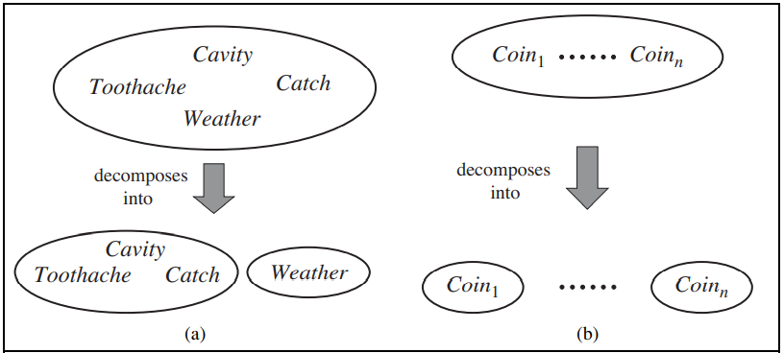
Independence
Real World Examples
Figure 4.2: Two examples of factoring a large joint distribution into smaller distributions, using absolute independence. (a) Weather and dental problems are independent. (b) Coin flips are independent.

Slide 26
Independence
Example: I pick a random number from {1,2,3,⋯,10}, and call it N. Suppose that all outcomes are equally likely. Let A be the event that N is less than 7, and let B be the event that N is an even number. Are A and B independent?
Answer: We have A={1,2,3,4,5,6} B={2,4,6,8,10}, and A∩B={2,4,6}. Then
P(A)=0.6,
P(B)=0.5,
P(A∩B)=0.3
Therefore, P(A∩B)=P(A)P(B), so A and B are independent. This means that knowing that B has occurred does not change our belief about the probability of A. In this problem the two events are about the same random number, but they are still independent because they satisfy the definition.

Slide 27

Baye’s Rule
Baye’s Theorem: Describes the probability of an event, based on the prior knowledge of conditions that might be related to the event.
In probability theory, it relates the conditional probability and marginal probability of two random events.
Suppose that we know P(a|b), but we are interested in the probability P(b|a). Using the definition of conditional probability, we have product rule: P(A∧ B) = P(A|B)P(B), It can actually be written in two forms:
P(A ⋀ B)= P(A|B) P(B) or P(A ⋀ B)= P(B|A) P(A)
Equating the two right-hand sides and dividing by P(a), we get
(4.4)

Slide 28
Baye’s Rule
This equation (4.4) is known as Bayes’ rule (also Bayes’ law or Bayes’ theorem).
This simple equation underlies most modern AI systems for probabilistic inference.
P(A|B) is known as posterior, which we need to calculate, and it will be read as Probability of hypothesis A when we have occurred an evidence B.
P(B|A) is called the likelihood, in which we consider that hypothesis is true, then we calculate the probability of evidence.
P(A) is called the prior probability, probability of hypothesis before considering the evidence
P(B) is called marginal probability, pure probability of an evidence.

Slide 29

Baye’s Rule
Applying Bayes' rule:
Bayes' rule allows us to compute the single term P(B|A) in terms of P(A|B), P(B), and P(A).
This is very useful in cases where we have a good probability of these three terms and want to determine the fourth one.
Suppose we want to perceive the effect of some unknown cause, and want to compute that cause, then the Bayes' rule becomes:

Slide 30
Baye’s Rule
Example-1: Question: what is the probability that a patient has diseases dengue with neck pain?
Given Data:
A doctor is aware that disease dengue causes a patient to have neck pain, and it occurs 80% of the time. He is also aware of some more facts, which are given as follows:
The Known probability that a patient has dengue disease is 1/30,000.
The Known probability that a patient has neck pain is 2%.
Let a be the proposition that patient has neck pain and b be the proposition that patient has dengue.

Slide 31

Baye’s Rule
so we can calculate the following as:
P(a|b) = 0.8
P(b) = 1/30000
P(a)= .02
Hence, we can assume that 1 patient out of 750 patients has dengue disease with neck pain.

Slide 32
Application of Bayes' theorem in AI
Following are some applications of Bayes' theorem:
It is used to calculate the next step of the robot when the already executed step is given.
Bayes' theorem is helpful in weather forecasting.
It can solve the Monty Hall problem.

Slide 33
Bayesian Belief Network in AI
Bayesian belief network is key computer technology for dealing with probabilistic events and to solve a problem which has uncertainty.
We can define a Bayesian network as:
"A Bayesian network is a probabilistic graphical model(PGM) which represents a set of variables and their conditional dependencies using a directed acyclic graph."
It is also called a Bayes network, belief network, decision network, or Bayesian model.
Bayesian networks are probabilistic, because these networks are built from a probability distribution, and also use probability theory for prediction and anomaly detection.
Real world applications are probabilistic in nature, and to represent the relationship between multiple events, we need a Bayesian network.

Slide 34
Bayesian Belief Network in AI
It can also be used in various tasks including prediction, anomaly detection, diagnostics, automated insight, reasoning, time series prediction, and decision making under uncertainty.
Bayesian Network can be used for building models from data and experts opinions, and it consists of two parts:
Directed Acyclic Graph
Table of conditional probabilities.
The generalized form of Bayesian network that represents and solve decision problems under uncertain knowledge is known as an Influence diagram.

Slide 35
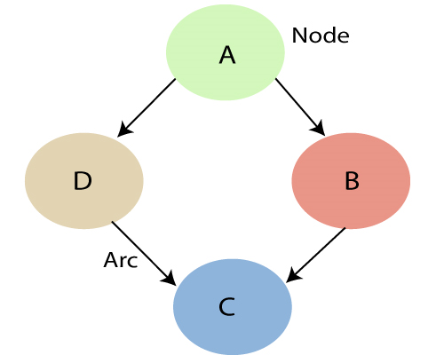
Bayesian Belief Network in AI
A Bayesian network graph is made up of nodes and Arcs (directed links), where:
Each node corresponds to the random variables, and a variable can be continuous or discrete.
Arc or directed arrows represent the causal relationship or conditional probabilities between random variables. These directed links or arrows connect the pair of nodes in the graph.
These links represent that one node directly influence the other node, and if there is no directed link that means that nodes are independent with each other
Figure 4.3: Two Bayesian Belief Network

Slide 36
Bayesian Belief Network in AI
In the above diagram, A, B, C, and D are random variables represented by the nodes of the network graph.
If we are considering node B, which is connected with node A by a directed arrow, then node A is called the parent of Node B.
Node C is independent of node A.

Slide 37
Bayesian Belief Network in AI
The Bayesian network has mainly two components:
Causal Component
Actual numbers
Each node in the Bayesian network has condition probability distribution
P(X_{i} |Parent(X_{i}) ),
which determines the effect of the parent on that node.
Bayesian network is based on Joint probability distribution and conditional probability.
So let's first understand the joint probability distribution.

Slide 38
Bayesian Belief Network in AI
Joint probability distribution:
If we have variables x₁, x₂, x₃,....., x_{n}, then the probabilities of a different combination of x₁, x₂, x₃,....., x_{n}, are known as Joint probability distribution.
P[x₁, x₂, x₃,....., x_{n}], it can be written as the following way in terms of the joint probability distribution.
= P[x₁| x₂, x₃,....., x_{n}]P[x₂, x₃,....., x_{n}]
= P[x₁| x₂, x₃,....., x_{n}]P[x₂|x₃,....., x_{n}]....P[x_{n-1}|x_{n}]P[x_{n}].
In general for each variable X_{i} , we can write the equation as:
P(X_{i}|X_{i-1},........., X₁) = P(X_{i} |Parents(X_{i} ))

Slide 39
Explanation of Bayesian network
Let's understand the Bayesian network through an example by creating a directed acyclic graph:
Example: Harry installed a new burglar alarm at his home to detect burglary. The alarm reliably responds at detecting a burglary but also responds for minor earthquakes. Harry has two neighbors John and Mary, who have taken a responsibility to inform Harry at work when they hear the alarm. John always calls Harry when he hears the alarm, but sometimes he got confused with the phone ringing and calls at that time too. On the other hand, Mary likes to listen to high music, so sometimes she misses to hear the alarm. Here we would like to compute the probability of Burglary Alarm.

Slide 40
Explanation of Bayesian network
Problem: Calculate the probability that alarm has sounded, but there is neither a burglary, nor an earthquake occurred, and John and Mary both called the Harry.
Solution:
The Bayesian network for the above problem is given below. The network structure is showing that burglary and earthquake is the parent node of the alarm and directly affecting the probability of alarm's going off, but John and Mary's calls depend on alarm probability.
The network is representing that our assumptions do not directly perceive the burglary and also do not notice the minor earthquake, and they also not confer before calling.
The conditional distributions for each node are given as conditional probabilities table or CPT.

Slide 41
Explanation of Bayesian network
Each row in the CPT must be sum to 1 because all the entries in the table represent an exhaustive set of cases for the variable.
In CPT, a boolean variable with k boolean parents contains 2^{K} probabilities. Hence, if there are two parents, then CPT will contain 4 probability values
List of all events occurring in this network:
Burglary (B)
Earthquake(E)
Alarm(A)
John Calls(J)
Mary calls(M)

Slide 42
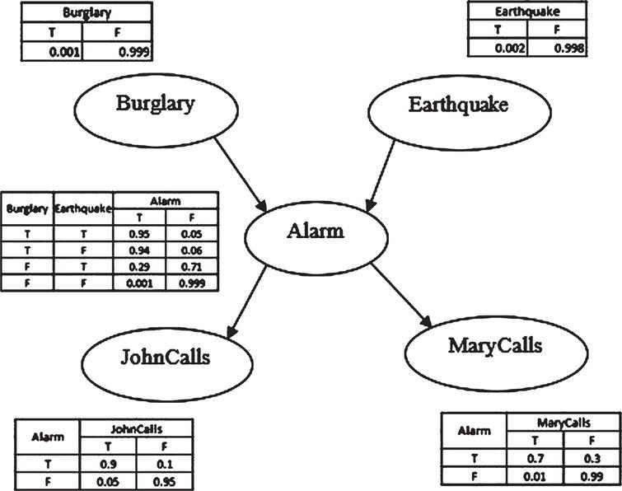
Explanation of Bayesian network
Figure 4.4: Alarm system example

Slide 43
Explanation of Bayesian network
Let's take the observed probability for the Burglary and earthquake component:
P(B= True) = 0.001, which is the probability of burglary.
P(B= False)= 0.999, which is the probability of no burglary.
P(E= True)= 0.002, which is the probability of a minor earthquake
P(E= False)= 0.998, Which is the probability that an earthquake not occurred.

Slide 44
Explanation of Bayesian network
We can provide the conditional probabilities as per the below tables:
Conditional probability table for Alarm A depends on Burglar and earthquake:
B | E | P(A= True) | P(A= False)
True | True | 0.95 | 0.05
True | False | 0.94 | 0.06
False | True | 0.29 | 0.71
False | False | 0.001 | 0.999

Slide 45
Explanation of Bayesian network
Conditional probability table for John Calls:
The Conditional probability of John that he will call depends on the probability of Alarm.
A | P(J= True) | P(J= False)
True | 0.9 | 0.1
False | 0.05 | 0.95

Slide 46
Explanation of Bayesian network
Conditional probability table for Mary Calls:
The Conditional probability of Mary that he will call depends on the probability of Alarm.
A | P(M= True) | P(M= False)
True | 0.7 | 0.3
False | 0.01 | 0.99

Slide 47
Explanation of Bayesian network
From the formula of joint distribution, we can write the problem statement in the form of probability distribution:
P(J ∧ M ∧ A ∧ ¬B ∧ ¬E) = P (J|A) *P (M|A)*P (A|¬B ^ ¬E) *P (¬B) *P (¬E).
= 0.9* 0.7* 0.001* 0.999*0.998
= 0.00062811
Hence, a Bayesian network can answer any query about the domain by using Joint distribution.
Homework: Find what is the probability that John call?

Slide 48
Explanation of Bayesian network
The semantics of Bayesian Network:
There are two ways to understand the semantics of the Bayesian network, which is given below:
1. To understand the network as the representation of the Joint probability distribution.
It is helpful to understand how to construct the network.
2. To understand the network as an encoding of a collection of conditional independence statements.
It is helpful in designing inference procedure.

Slide 49
Probabilistic Inference
The basic task for any probabilistic inference system is to compute the posterior probability distribution for a set of query variables, given some observed event—that is, some assignment of values to a set of evidence variables.
We will use the notation:
X denotes the query variable;
E denotes the set of evidence variables E1,...,Em, and e is a particular observed event;
Y will denotes the nonevidence, nonquery variables Y1,...,Yl (called the hidden variables).
Thus, the complete set of variables is X = {X} ∪ E ∪ Y.
A typical query asks for the posterior probability distribution P(X | e).

Slide 50
Probabilistic Inference
In the burglary network, we might observe the event in which JohnCalls = true and MaryCalls = true.
We could then ask for, say, the probability that a burglary has occurred:
P(Burglary | JohnCalls = true, MaryCalls = true) = 0.284, 0.716 .
Two types of probabilistic Inferences are:
Inference by enumeration: inference by listing or recording all variables.
The variable elimination algorithm: inference by variable removal.

Slide 51


Inference by enumeration
Any conditional probability can be computed by summing terms from the full joint distribution.
More specifically, a query P(X | e) can be answered using Equation:
Where α is normalized constant, X-query variable, e-event and y-no.of terms.
The following equation shows that the terms P(x, e, y) in the joint distribution can be written as products of conditional probabilities from the network
Therefore, a query can be answered using a Bayesian network by computing sums of products of conditional probabilities from the network.

Slide 52
Inference by enumeration
Consider the query P(Burglary | JohnCalls = true, MaryCalls = true).
Burglary - query variable
JohnCalls - Evidence Variable1 (E1)
MaryCalls - Evidence Variable2 (E2)
The hidden variables for this query are Earthquake and Alarm.

Slide 53


Inference by enumeration
Using initial letters for the variables to shorten the expressions, we have
The semantics of Bayesian networks then gives us an expression in terms of CPT entries. For simplicity, we do this just for Burglary = true:
To compute this expression, we have to add four terms, each computed by multiplying five numbers.

Slide 54
Inference by enumeration
An improvement can be obtained from the following simple observations: the P(b) term is a constant and can be moved outside the summations over a and e, and the P(e) term can be moved outside the summation over a. Hence, we have:
This expression can be evaluated by looping through the variables in order, multiplying CPT entries as we go.
For each summation, we also need to loop over the variable’s possible values.
The structure of this computation is shown in the next slide Figure 4.5.

Slide 55
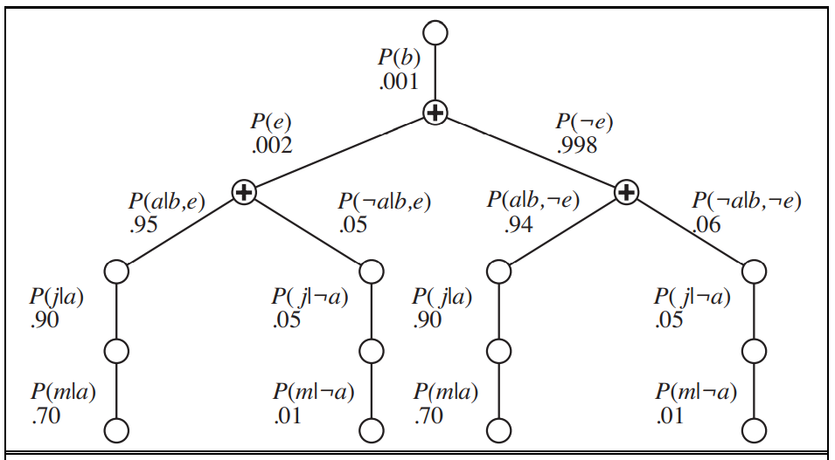
Inference by enumeration
Figure 4.5: Alarm system example

Slide 56
Inference by enumeration
Using the numbers from Figure 4.4, we obtain P(b | j, m) = α × 0.00059224. The corresponding computation for ¬b yields α × 0.0014919; hence,
That is, the chance of a burglary, given calls from both neighbors, is about 28%.

Slide 57

The variable elimination algorithm
The enumeration algorithm can be improved substantially by eliminating repeated calculations of the kind illustrated in Figure 4.5.
The idea is simple: do the calculation once and save the results for later use.
This is a form of dynamic programming.
Variable elimination works by evaluating expressions in right-to-left order (that is, bottom up in Figure 4.5).
Intermediate results are stored, and summations over each variable are done only for those portions of the expression that depend on the variable.
Let us illustrate this process for the burglary network. We evaluate the expression

Slide 58
The variable elimination algorithm
Notice that we have annotated each part of the expression with the name of the corresponding factor; each factor is a matrix indexed by the values of its argument variables.
For example, the factors f4(A) and f5(A) corresponding to P(j | a) and P(m | a) depend just on A because J and M are fixed by the query.
They are therefore two-element vectors:
f3(A, B, E) will be a 2 × 2 × 2 matrix, which is hard to show on the printed page. (The “first” element is given by P(a | b, e)=0.95 and the “last” by P(¬a | ¬b,¬e)=0.999.)

Slide 59
The variable elimination algorithm
In terms of factors, the query expression is written as
where the “×” operator is not ordinary matrix multiplication but instead the pointwise product operation, to be described shortly.
The process of evaluation is a process of summing out variables (right to left) from pointwise products of factors to produce new factors, eventually yielding a factor that is the solution, i.e., the posterior distribution over the query variable.

Slide 60
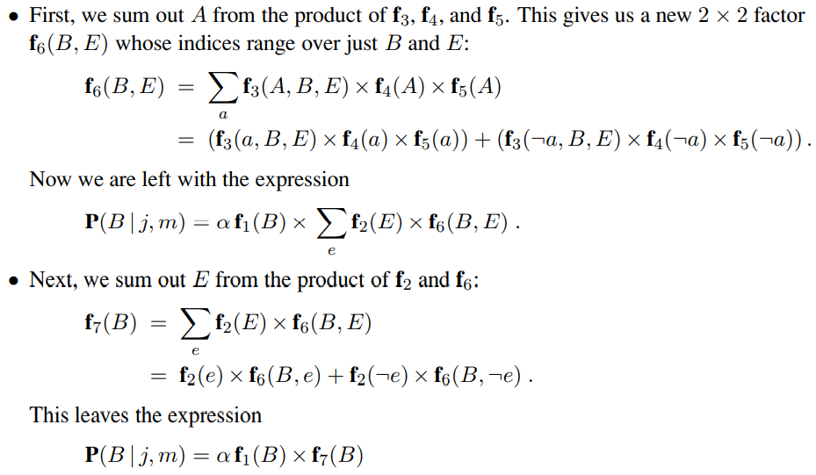
The variable elimination algorithm
The steps are as follows:
which can be evaluated by taking the pointwise product and normalizing the result.

Slide 61
The variable elimination algorithm
Examining this sequence, we see that two basic computational operations are required: - pointwise product of a pair of factors, and
- summing out a variable from a product of factors.
Pointwise product of a pair of factors
The pointwise product of two factors f₁ and f₂ yields a new factor f whose variables are the union of the variables in f₁ and f₂ and whose elements are given by the product of the corresponding elements in the two factors.
Suppose the two factors have variables Y₁,...,Y_{k} in common. Then we have
f(X₁ ...X_{j} , Y₁ ...Y_{k}, Z₁ ...Z_{l}) = f1(X₁ ...X_{j} , Y₁ ...Y_{k}) f2(Y₁ ...Y_{k}, Z₁ ...Z_{l}).

Slide 62
The variable elimination algorithm
If all the variables are binary, then f₁ and f₂ have 2^{j+k} and 2^{k+l} entries, respectively, and the pointwise product has 2^{j+k+l} entries.
For example, given two factors f₁(A, B) and f₂(B,C), the pointwise product f₁ × f₂ = f₃(A, B, C) has 2¹⁺¹⁺¹ = 8 entries, as illustrated in Figure 4.6. In next slide.
Notice that the factor resulting from a pointwise product can contain more variables than any of the factors being multiplied and that the size of a factor is exponential in the number of variables.
This is where both space and time complexity arise in the variable elimination algorithm.

Slide 63
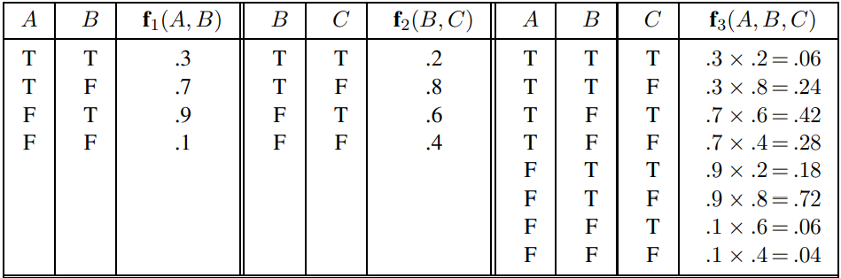
The variable elimination algorithm
Figure 4.6: Illustrating pointwise multiplication: f₁(A, B) × f₂(B,C) = f₃(A, B, C).

Slide 64
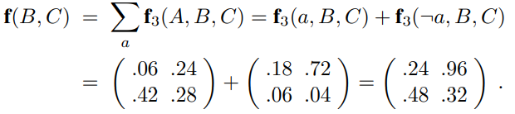
The variable elimination algorithm
Summing out a variable from a product of factors is done by adding up the submatrices formed by fixing the variable to each of its values in turn.
For example, to sum out A from f₃(A, B, C), we write
The only trick is to notice that any factor that does not depend on the variable to be summed out can be moved outside the summation.
For example, if we were to sum out E first in the burglary network, the relevant part of the expression would be

Slide 65
The variable elimination algorithm
Now the pointwise product inside the summation is computed, and the variable is summed out of the resulting matrix.
Notice that matrices are not multiplied until we need to sum out a variable from the accumulated product.
At that point, we multiply just those matrices that include the variable to be summed out.

Slide 66


